Slide 2
Attraction-Repulsion Model
Osaka University Graduate School of Medicine
Presenter: Luke Kersting

Slide 3
Outline
Introduction
Model Criteria
Optimization Grid
Dose
Objective Function
Seed Position
Results
Conclusion

Slide 4
Introduction
Objective
Program to objectively determine an optimum seed configuration at time of implantation.
Attraction-Repulsion Model
Derived from Gauss’ law of electromagnetism
Treat seeds as charges inside a conductor
Optimization is reached when seeds are in equilibrium

Slide 5
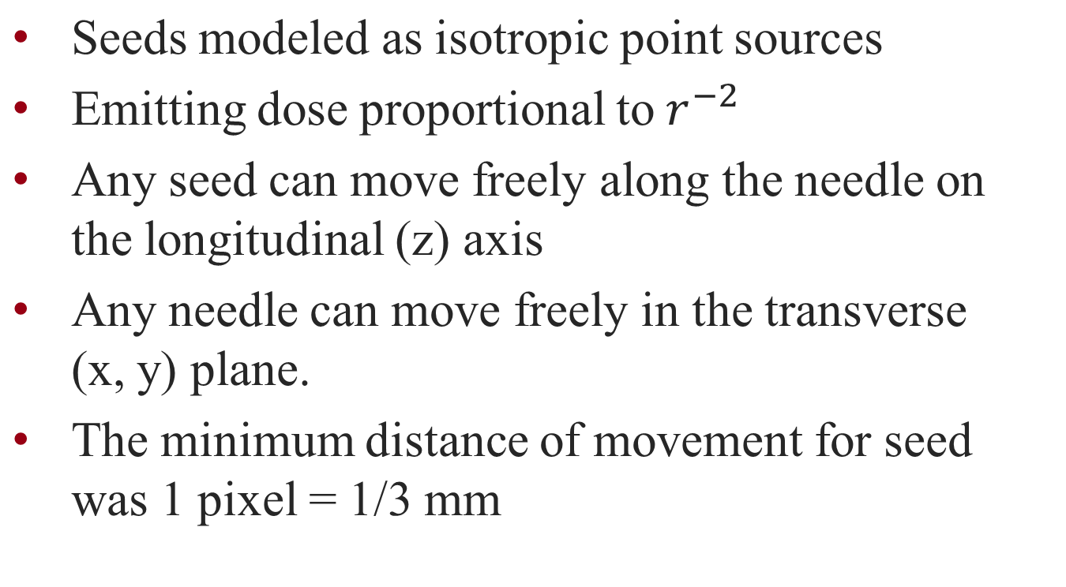
Intro (continued)

Slide 6
Model Criteria*
Density of optimization grid points in the area of interest is uniform.
All optimization grid points have some attribution (attraction or repulsion).
Optimization grid points generate attraction or repulsion depending on dose or dose rate.
For each optimization grid point, attraction is defined as the force generated to increase dose or dose rate; repulsion is defined as the force generated to decrease dose or dose rate.
Both attraction and repulsion are determined as the function of dose or dose rate.
Optimization grid gives attraction or repulsion for one parameter of the source. For example, one parameter of the source is source position in permanent implant.
*Taken directly from paper

Slide 7
Optimization Grid
Frame grabber is used to capture ultrasound images of the prostate at 5 mm intervals
The contours of prostate (target), urethra, and rectum (critical organs) were drawn by the radiation oncologist on captured images
Optimization point were defined every 3 pixels = 1 mm
The total area of optimization was 240 x 240 pixels for 15 slices

Slide 8
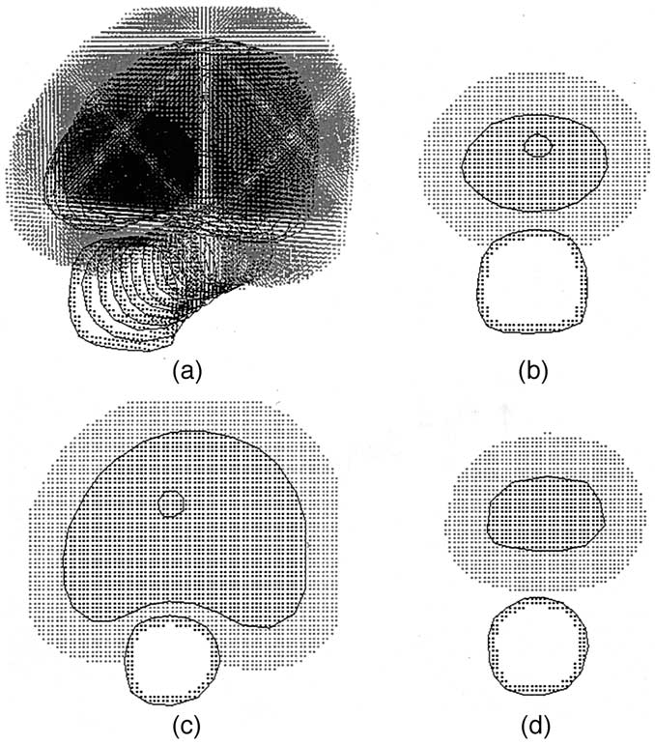
Optimization Grid
Contour of prostate, urethra, and rectum, and optimization grids.
The apex of the prostate
The axial midplane of the prostate
The base of the prostate
Includes surrounding normal tissue
Contours manually drawn by physician
Fig 1

Slide 9
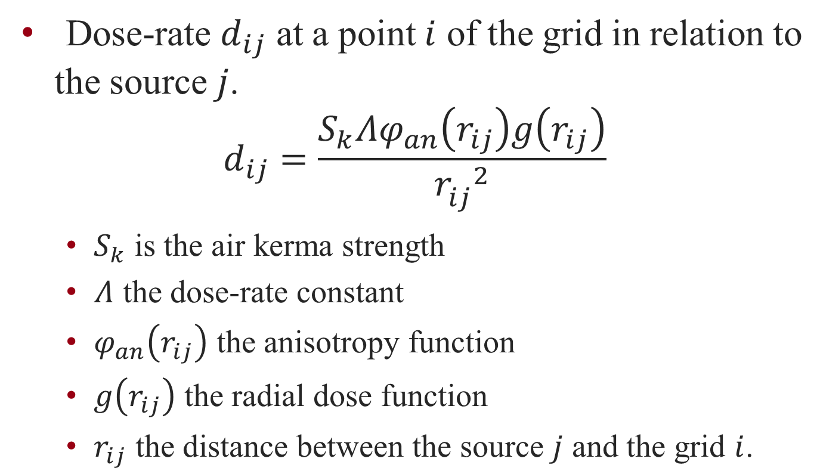
Dose Rate

Slide 10
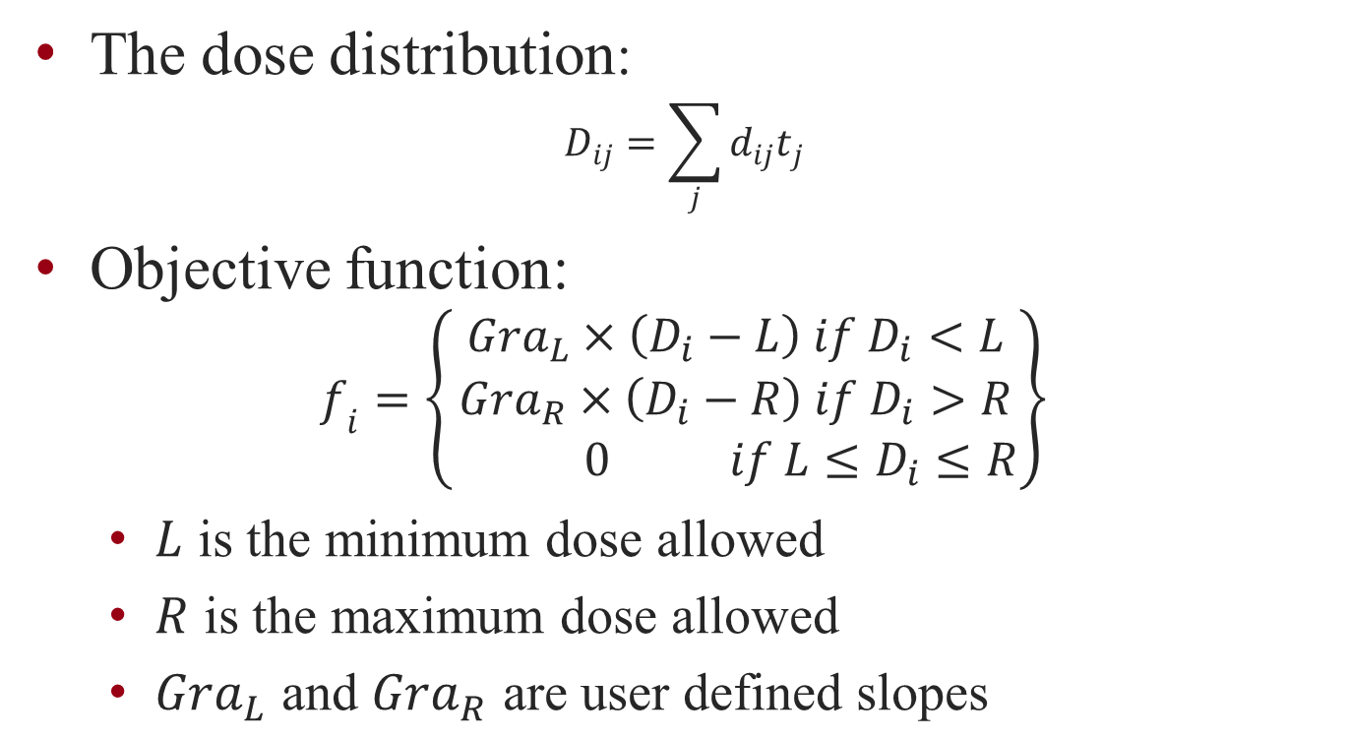
Dose and Objective Function

Slide 11
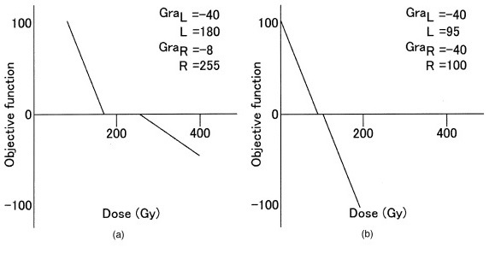
Objective Function
(a) target-dose potential (b) urethra-dose potential

Slide 12
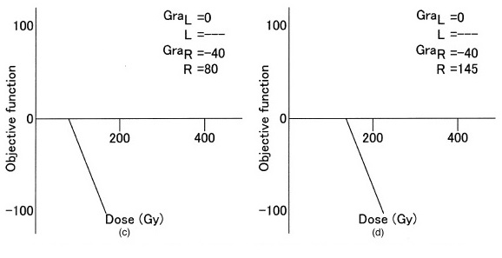
Objective Function
(c) rectum-dose potential (d) normal tissue-dose potential

Slide 13

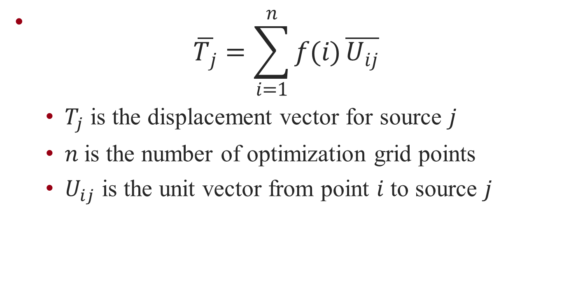

Slide 14
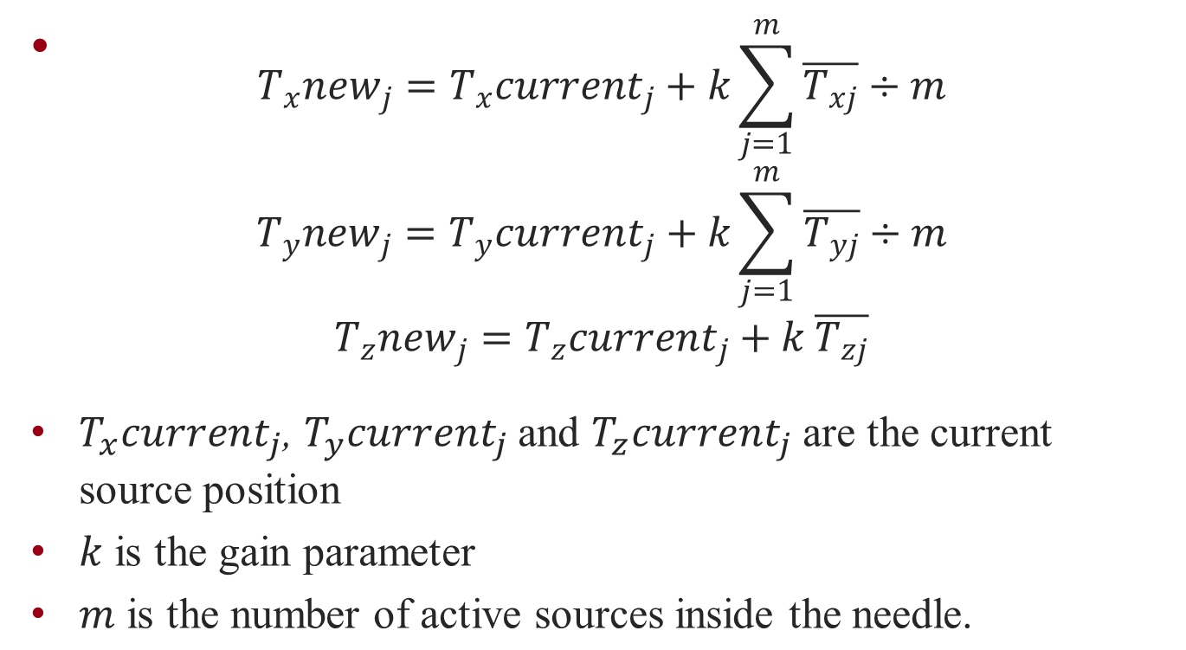
New Seed Position

Slide 15
Additional Aspects
To avoid local minima, the gain parameter, k was decreased gradually during the iterative calculation
“A computer variable was implemented in the repulsion process, independent of dose, to avoid overlapping of sources.”

Slide 16
Test Case
14 needles randomly placed.
Seeds are spaced out along the needles ever 5 mm
Seeds are active inside the prostate contours and inactive outside the prostate contours
Dose prescription was set to 145 Gy

Slide 17
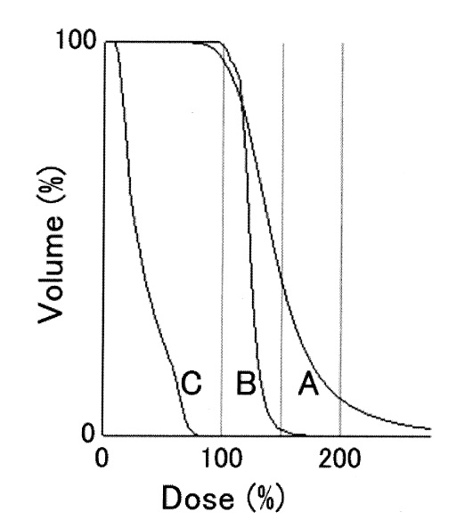
Results
 | Target | Urethra | Rectum
V100 | 95% | < 95% | 0%
V150 | 39% | 2% | 0%
V200 | 9% | 0% | 0%
Dose–volume histograms of the target (a), urethra (b), and rectal wall (c) of optimization plan
Percent volume receiving ≥ 100% , 150% and 200% of the prescribed dose

Slide 18
Conclusion
The running time on the Pentium III (1 GHz) was approximately 5 min
Wanted to add a needle template with 0.5-cm rectilinear grid spacing
Result only shown for one case
No option for directional or multi-species seeds
Number of needles and seeds are fixed

Slide 19
Questions?

